Slide 1
?
WHAT IS

Slide 2
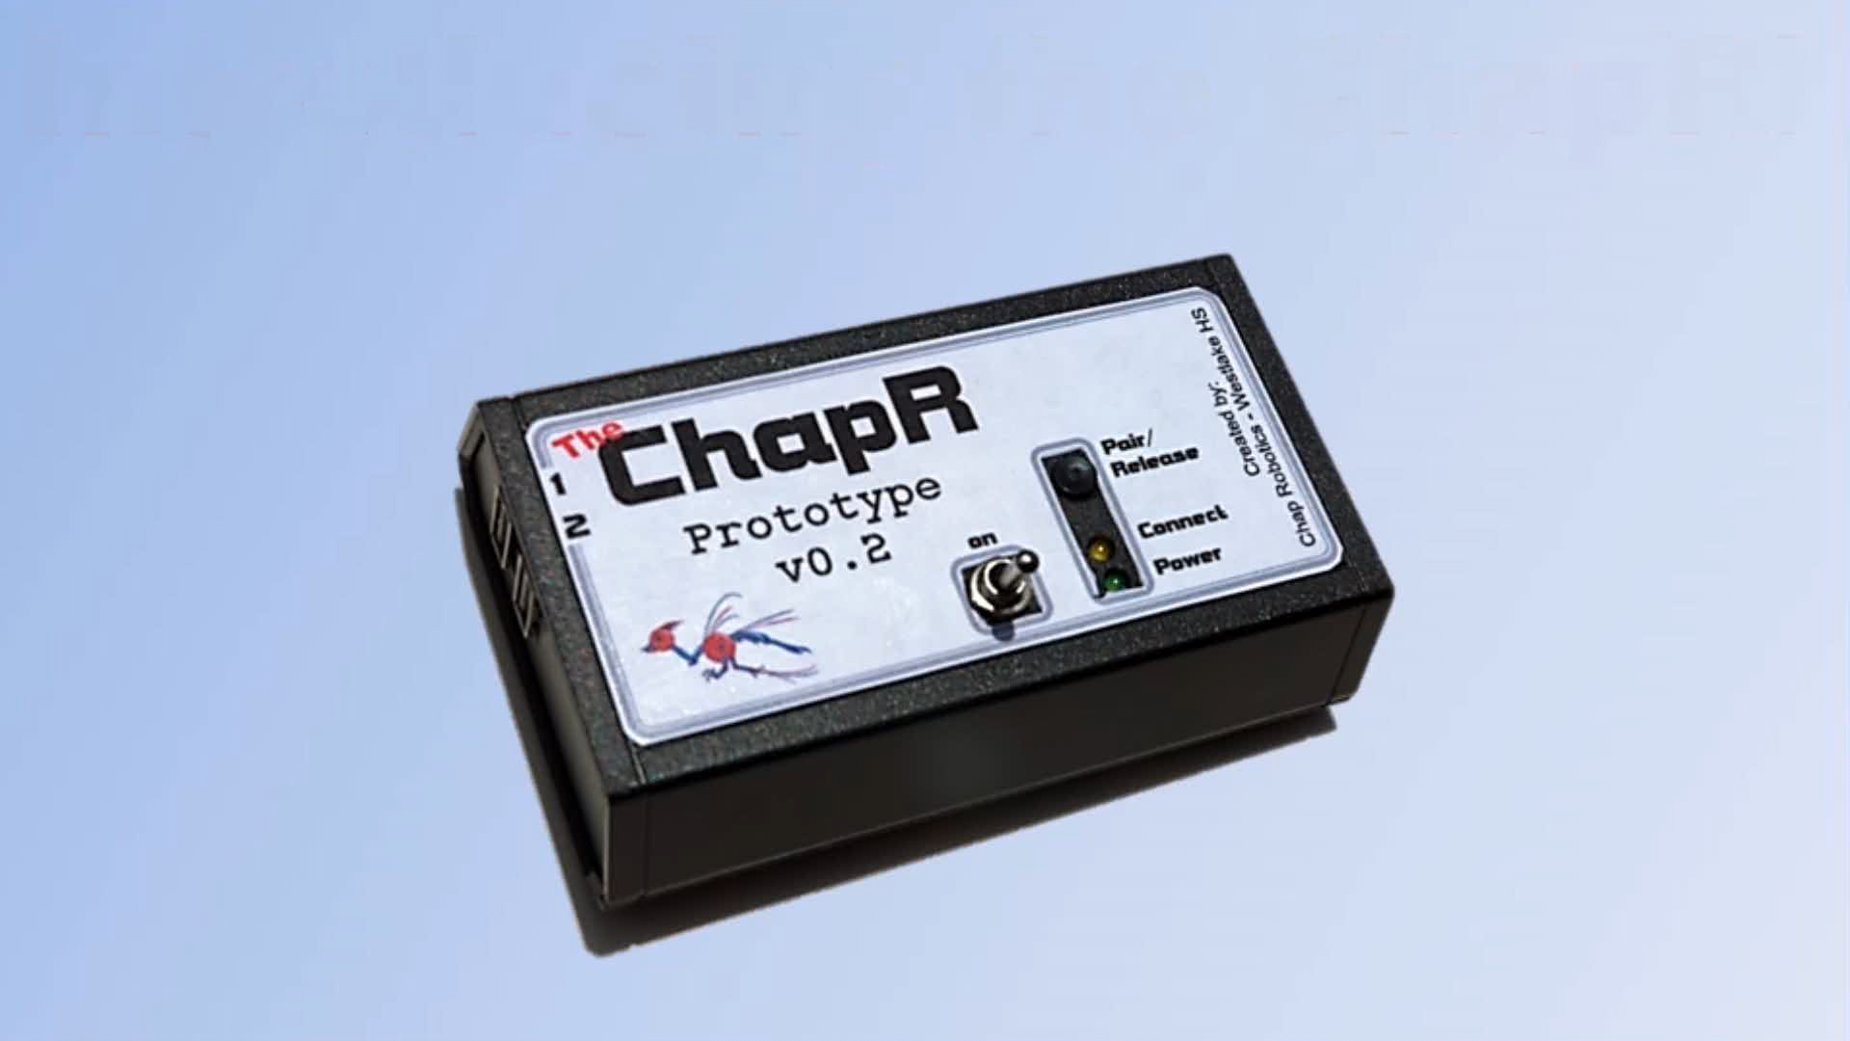

Slide 3
Features
With
Akshay Prakash

Slide 4
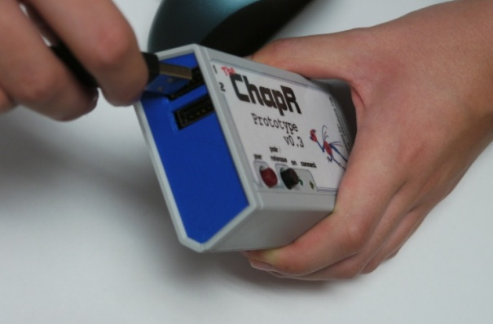
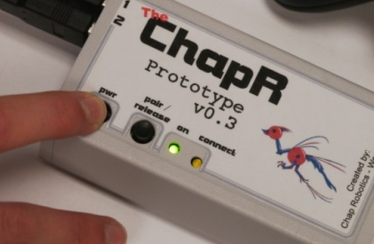
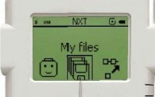
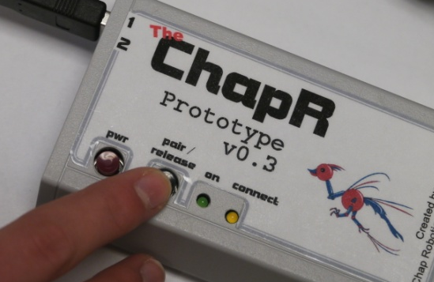
Driving
1.
Plug in joysticks
2.
Hold power button to turn on
3.
Select program
4.
Hit the action button if needed

Slide 5

The Kill Switch
Tap power button to abort program
TAP
Hold power button to turn off ChapR
HOLD

Slide 6
Pairing
Via Bluetooth
Hold down both buttons on the ChapR
Use NXT menus to find the ChapR and connect with it

Slide 7
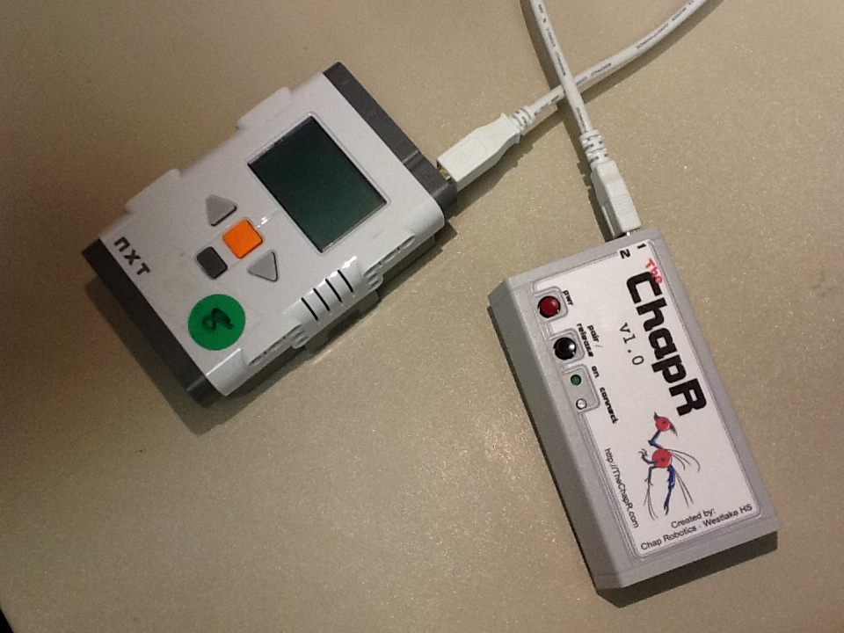
Pairing Continued
Via USB
Make sure Bluetooth is on
Plug in the cable

Slide 8
Configurable
Configurable via flash drive or serial port
name - the name of the ChapR
timeout - the time before the ChapR turns itself off
lag - the time between sending messages
mode - tele-op or autonomous
personality - the compatibility of the ChapR with various “flavors” of programs
NXT-RobotC
NXT-G
NXT-LabView

Slide 9
Tele-Op Remote Start
In progress!
Implementing the ability to start the program from afar using the action button
Uses the program that has been loaded into Program Chooser

Slide 10
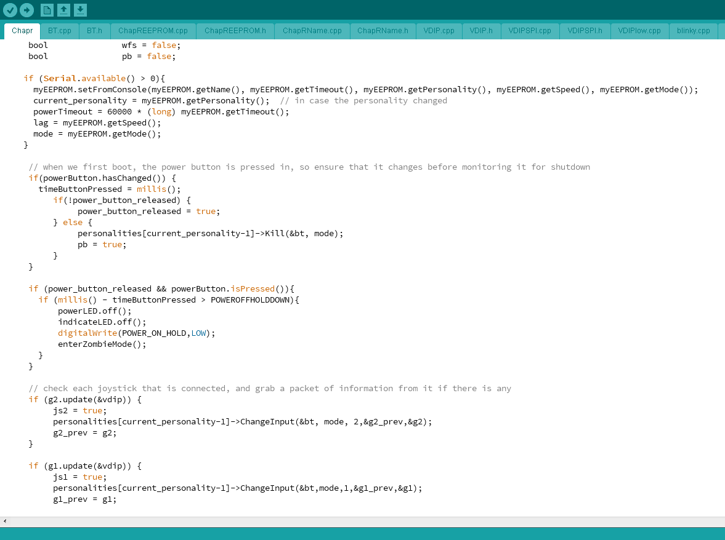
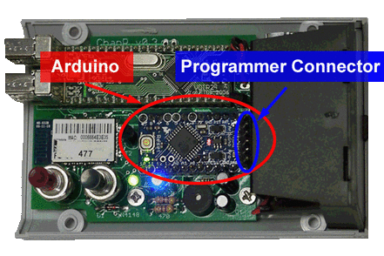
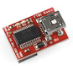
Programmable
The programmer and code on our website can be used to reprogram the ChapR

Slide 11
Hardware
With
Ben Gorr

Slide 12
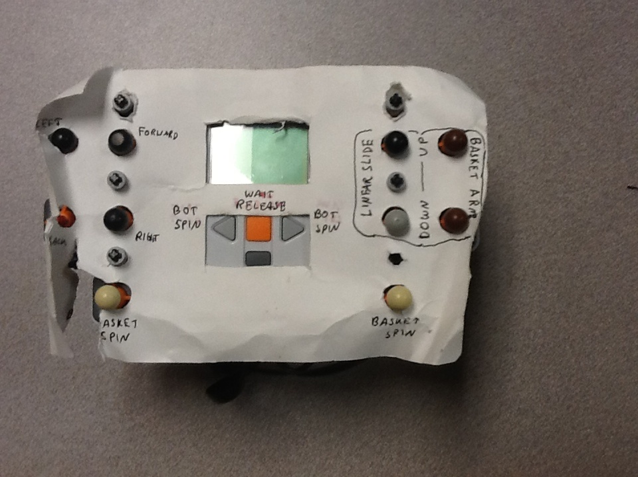
History of Hardware – starting with the NXT Remote!

Slide 13
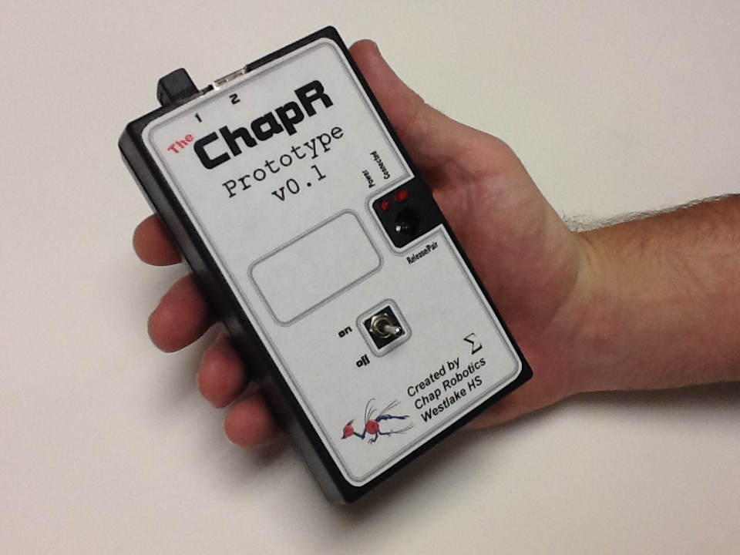
first ChapR made of shield

Slide 14
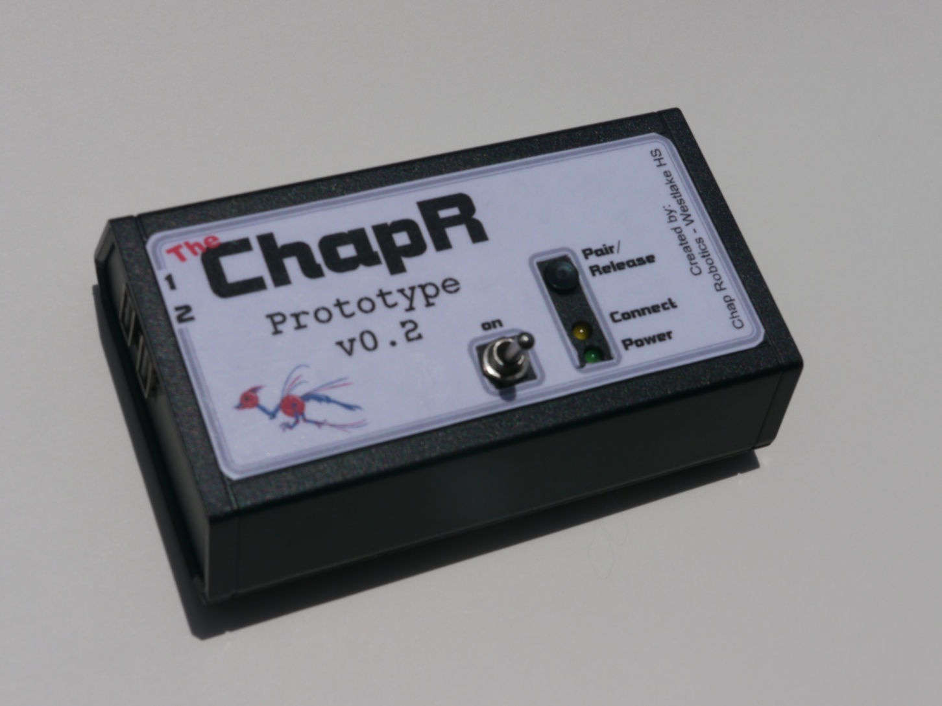
v0.2 – condensed design!

Slide 15
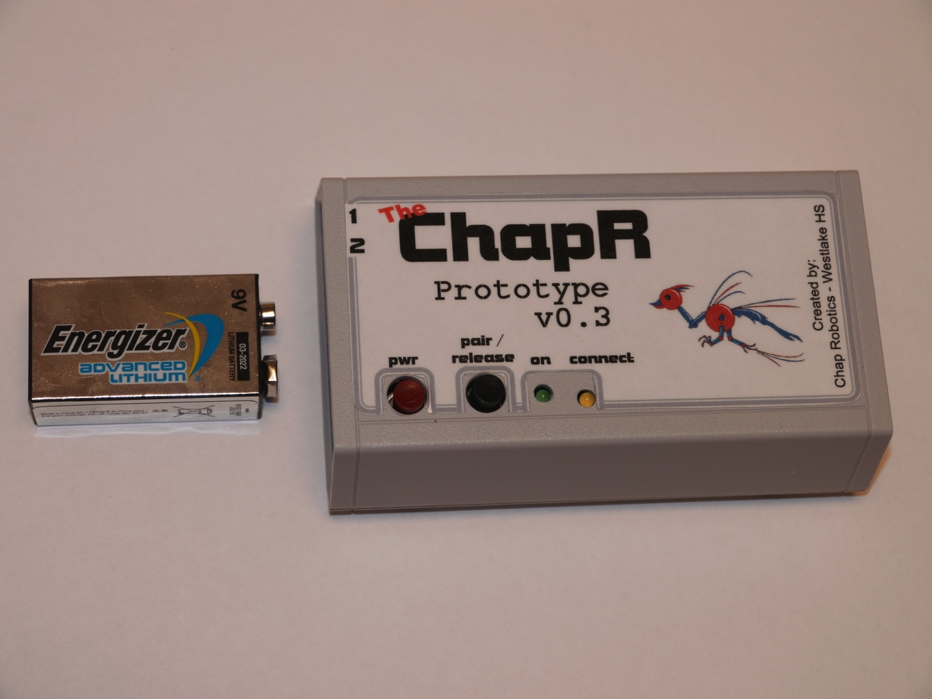
v0.3 – Updated case and Board!

Slide 16
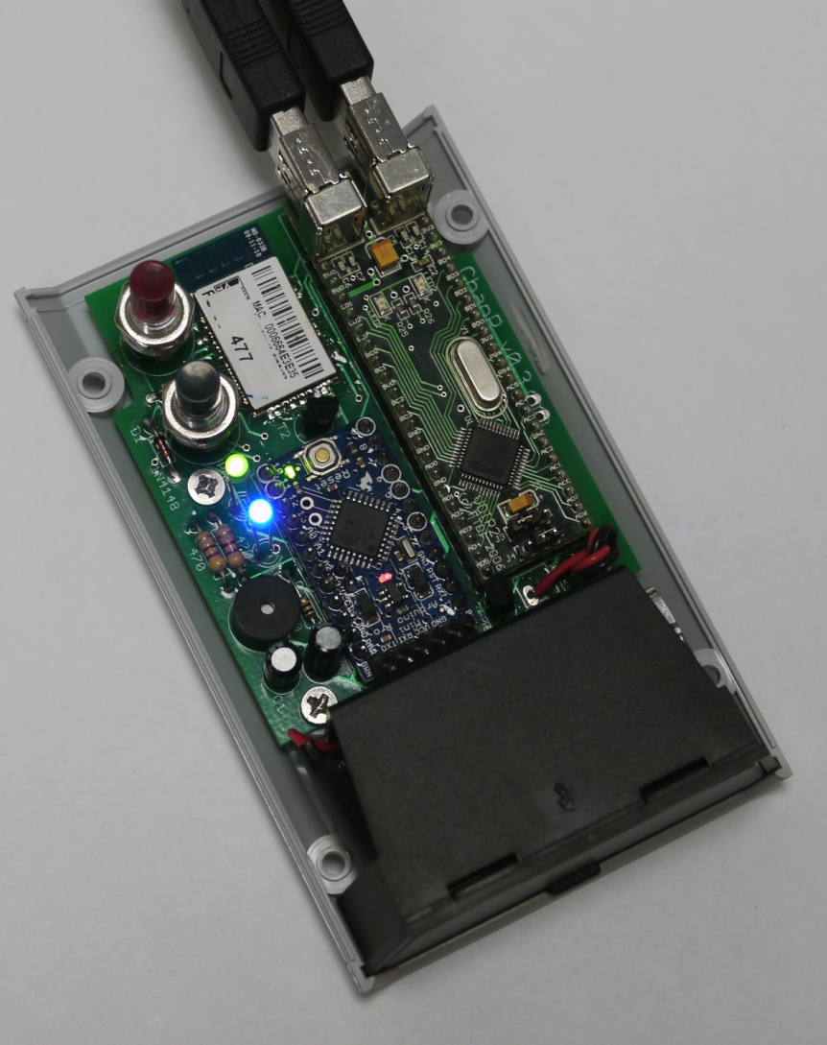
v1.0 – Release version!
RN-42
Arduino Pro-Mini
VDIP

Slide 17
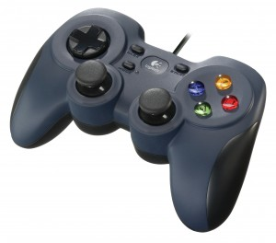
Port 1
USB Interface (VDIP)
Bluetooth Transmitter (RN-42)
Port 2
Connected?
Joystick Data
BT Packets
Microprocessor (Arduino Pro-Mini)

Slide 18
Manufacturing Process
PCB done in Eagle and manufactured by Futurlec.
We receive the board, then solder the parts in place and manufacture case.
Case is modified off-the-shelf unit.
Board manufacturing process takes 1 hour 30 minutes!
If orders start becoming too much to handle we may outsource production, but for now we enjoy building them ourselves.

Slide 19
Software
With
Rachel Gardner

Slide 20
The Software
Arduino Sketch written in C
Versioned using an EEPROM (local memory on the Arduino) “magic string”
Managed using an SVN
22 subclasses
Check out www.TheChapR.com/build-your-own to see the actual copy

Slide 21
Power Up
Initialize Bluetooth
Set Up
Initialize VDIP
Read EEPROM
Checks if Serial is available
Kill switch
If available
Configure EEPROM
held
Turn off
tapped
If PWR
Check buttons
If USB
Release WFS
If WFS
Check for device in VDIP
If joystick
Grab joystick packets
Check personality
If NXT
Connect to NXT
If BT connected
Check connection
Send data to NXT
Checks inactivity
Power off ChapR
If greater than timeout
Lag is added
Check EEPROM

Slide 22
Business Model
With
Rachel Gardner

Slide 23
Moving Forward
Selling each for $100 with a production cost of $75
Shipping out one charity ChapR for every 3 sold
All production is done by Westlake high school students volunteering their time
We’re building as fast as we can

Slide 24
Moving Forward
WESTA is our 501(c)3 non-profit organization
Working on filing a patent
Chap Robotics is trying to give back to the FIRST community
Learned marketing, software, hardware, manufacturing and design.
www.TheChapR.com has support systems for using the ChapR

Slide 25
Questions? Feedback?
Any ways to spread the word?
Advice for manufacturing or production?
General feedback?
Uses we didn’t think of?
See www.TheChapR.com to get more information, donate or order!

